Slide 1

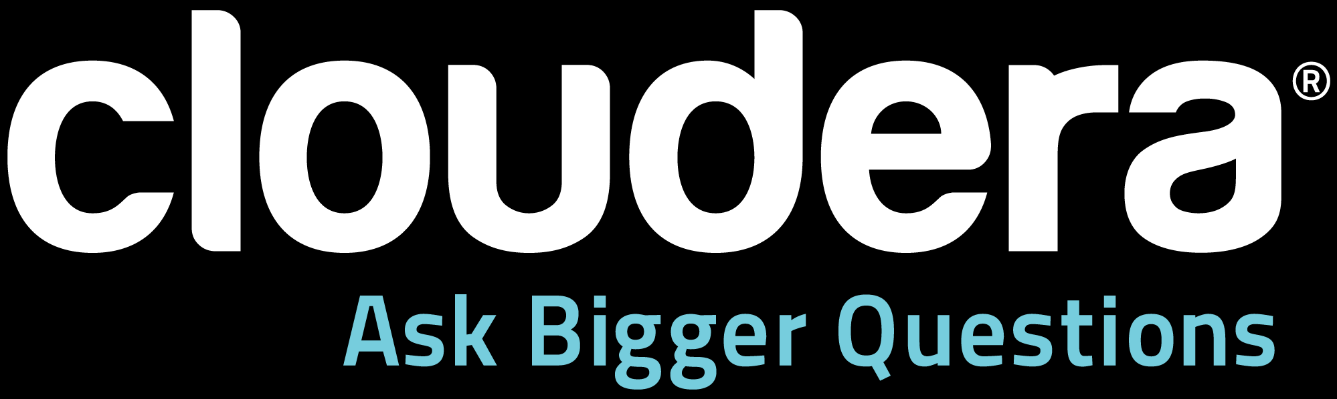
Building a Data Collection System with Apache Flume
Headline Goes Here
DO NOT USE PUBLICLY PRIOR TO 10/23/12
Arvind Prabhakar, Prasad Mujumdar, Hari Shreedharan, Will McQueen, and Mike Percy
October 2012
Speaker Name or Subhead Goes Here

Slide 2
Apache Flume
Headline Goes Here
DO NOT USE PUBLICLY PRIOR TO 10/23/12
Arvind Prabhakar | Engineering Manager, Cloudera
October 2012
Speaker Name or Subhead Goes Here

Slide 3
What is Flume
Collection, Aggregation of streaming Event Data
Typically used for log data
Significant advantages over ad-hoc solutions
Reliable, Scalable, Manageable, Customizable and High Performance
Declarative, Dynamic Configuration
Contextual Routing
Feature rich
Fully extensible

Slide 4
Core Concepts: Event
An Event is the fundamental unit of data transported by Flume from its point of origination to its final destination. Event is a byte array payload accompanied by optional headers.
Payload is opaque to Flume
Headers are specified as an unordered collection of string key-value pairs, with keys being unique across the collection
Headers can be used for contextual routing

Slide 5
Core Concepts: Client
An entity that generates events and sends them to one or more Agents.
Example
Flume log4j Appender
Custom Client using Client SDK (org.apache.flume.api)
Decouples Flume from the system where event data is consumed from
Not needed in all cases

Slide 6
Core Concepts: Agent
A container for hosting Sources, Channels, Sinks and other components that enable the transportation of events from one place to another.
Fundamental part of a Flume flow
Provides Configuration, Life-Cycle Management, and Monitoring Support for hosted components

Slide 7
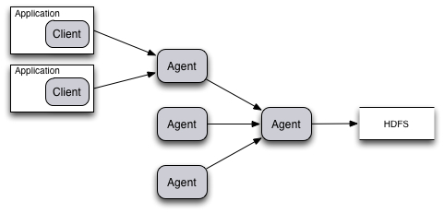
Typical Aggregation Flow
[Client]⁺ → Agent [→ Agent]* → Destination

Slide 8
Core Concepts: Source
An active component that receives events from a specialized location or mechanism and places it on one or Channels.
Different Source types:
Specialized sources for integrating with well-known systems. Example: Syslog, Netcat
Auto-Generating Sources: Exec, SEQ
IPC sources for Agent-to-Agent communication: Avro
Require at least one channel to function

Slide 9
Core Concepts: Channel
A passive component that buffers the incoming events until they are drained by Sinks.
Different Channels offer different levels of persistence:
Memory Channel: volatile
File Channel: backed by WAL implementation
JDBC Channel: backed by embedded Database
Channels are fully transactional
Provide weak ordering guarantees
Can work with any number of Sources and Sinks.

Slide 10
Core Concepts: Sink
An active component that removes events from a Channel and transmits them to their next hop destination.
Different types of Sinks:
Terminal sinks that deposit events to their final destination. For example: HDFS, HBase
Auto-Consuming sinks. For example: Null Sink
IPC sink for Agent-to-Agent communication: Avro
Require exactly one channel to function

Slide 11
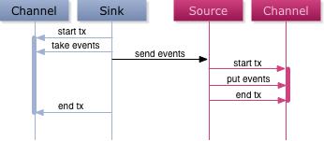
Flow Reliability
Reliability based on:
Transactional Exchange between Agents
Persistence Characteristics of Channels in the Flow
Also Available:
Built-in Load balancing Support
Built-in Failover Support

Slide 12
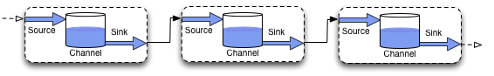
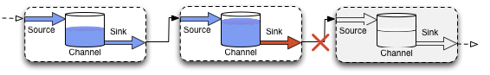
Flow Reliability
Normal Flow
Communication Failure between Agents
Communication Restored, Flow back to Normal

Slide 13
Flow Handling
Channels decouple impedance of upstream and downstream
Upstream burstiness is damped by channels
Downstream failures are transparently absorbed by channels
→ Sizing of channel capacity is key in realizing these benefits

Slide 14
Configuration
Java Properties File Format
# Comment line
key1 = value
key2 = multi-line \
value
Hierarchical, Name Based Configuration
agent1.channels.myChannel.type = FILE
agent1.channels.myChannel.capacity = 1000
Uses soft references for establishing associations
agent1.sources.mySource.type = HTTP
agent1.sources.mySource.channels = myChannel

Slide 15
Configuration
Global List of Enabled Components
agent1.soruces = mySource1 mySource2
agent1.sinks = mySink1 mySink2
agent1.channels = myChannel
...
agent1.sources.mySource3.type = Avro
...
Custom Components get their own namespace
agent1.soruces.mySource1.type = org.example.source.AtomSource
agent1.sources.mySource1.feed = http://feedserver.com/news.xml
agent1.sources.mySource1.cache-duration = 24
...

Slide 16
Configuration
Active Agent Components
(Sources, Channels, Sinks)
Individual Component Configuration
agent1.properties:
# Active components
agent1.sources = src1
agent1.channels = ch1
agent1.sinks = sink1
# Define and configure src1
agent1.sources.src1.type = netcat
agent1.sources.src1.channels = ch1
agent1.sources.src1.bind = 127.0.0.1
agent1.sources.src1.port = 10112
# Define and configure sink1
agent1.sinks.sink1.type = logger
agent1.sinks.sink1.channel = ch1
# Define and configure ch1
agent1.channels.ch1.type = memory

Slide 17
Configuration
A configuration file can contain configuration information for many Agents
Only the portion of configuration associated with the name of the Agent will be loaded
Components defined in the configuration but not in the active list will be ignored
Components that are misconfigured will be ignored
Agent automatically reloads configuration if it changes on disk

Slide 18
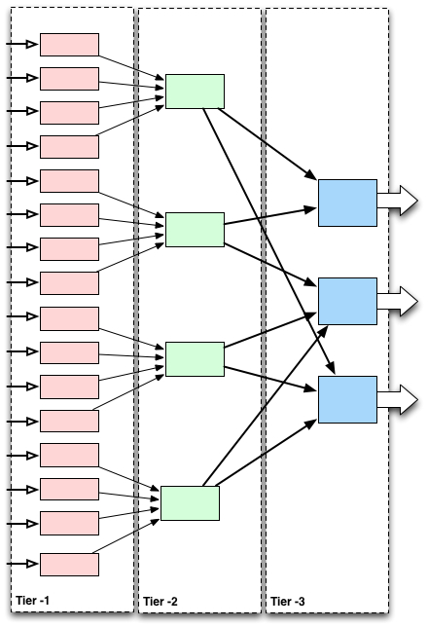
Configuration
Typical Deployment
All agents in a specific tier could be given the same name
One configuration file with entries for three agents can be used throughout

Slide 19
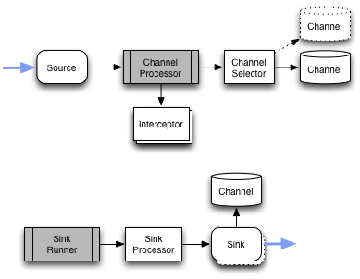
Contextual Routing
Achieved using Interceptors and Channel Selectors

Slide 20
Contextual Routing
Interceptor
An Interceptor is a component applied to a source in pre-specified order to enable decorating and filtering of events where necessary.
Built-in Interceptors allow adding headers such as timestamps, hostname, static markers etc.
Custom interceptors can introspect event payload to create specific headers where necessary

Slide 21
Contextual Routing
Channel Selector
A Channel Selector allows a Source to select one or more Channels from all the Channels that the Source is configured with based on preset criteria.
Built-in Channel Selectors:
Replicating: for duplicating the events
Multiplexing: for routing based on headers

Slide 22
Channel Selector Configuration
Applied via Source configuration under namespace “selector”
# Active components
agent1.sources = src1
agent1.channels = ch1 ch2
agent1.sinks = sink1 sink2
# Configure src1
agent1.sources.src1.type = AVRO
agent1.sources.src1.channels = ch1 ch2
agent1.sources.src1.selector.type = multiplexing
agent1.sources.src1.selector.header = priority
agent1.sources.src1.selector.mapping.high = ch1
agent1.sources.src1.selector.mapping.low = ch2
agent1.sources.src1.selector.default = ch2
...

Slide 23
Contextual Routing
Terminal Sinks can directly use Headers to make destination selections
HDFS Sink can use headers values to create dynamic path for files that the event will be added to.
Some headers such as timestamps can be used in a more sophisticated manner
Custom Channel Selector can be used for doing specialized routing where necessary

Slide 24
Load Balancing and Failover
Sink Processor
A Sink Processor is responsible for invoking one sink from an assigned group of sinks.
Built-in Sink Processors:
Load Balancing Sink Processor – using RANDOM, ROUND_ROBIN or Custom selection algorithm
Failover Sink Processor
Default Sink Processor

Slide 25
Sink Processor
Invoked by Sink Runner
Acts as a proxy for a Sink

Slide 26
Sink Processor Configuration
Applied via “Sink Groups”
Sink Groups declared at global level:
# Active components
agent1.sources = src1
agent1.channels = ch1
agent1.sinks = sink1 sink2 sink3
agent1.sinkgroups = foGroup
# Configure foGroup
agent1.sinkgroups.foGroup.sinks = sink1 sink3
agent1.sinkgroups.foGroup.processor.type = failover
agent1.sinkgroups.foGroup.processor.priority.sink1 = 5
agent1.sinkgroups.foGroup.processor.priority.sink3 = 10
agent1.sinkgroups.foGroup.processor.maxpenalty = 1000

Slide 27
Sink Processor Configuration
A Sink can exist in at most one group
A Sink that is not in any group is handled via Default Sink Processor
Caution:
Removing a Sink Group does not make the sinks inactive!

Slide 28
Summary
Clients send Events to Agents
Agents hosts number Flume components – Source, Interceptors, Channel Selectors, Channels, Sink Processors, and Sinks.
Sources and Sinks are active components, where as Channels are passive
Source accepts Events, passes them through Interceptor(s), and if not filtered, puts them on channel(s) selected by the configured Channel Selector
Sink Processor identifies a sink to invoke, that can take Events from a Channel and send it to its next hop destination
Channel operations are transactional to guarantee one-hop delivery semantics
Channel persistence allows for ensuring end-to-end reliability

Slide 29

Questions?
?

Slide 30
Flume Sources
Headline Goes Here
DO NOT USE PUBLICLY PRIOR TO 10/23/12
Prasad Mujumdar | Software Engineer, Cloudera
October 2012
Speaker Name or Subhead Goes Here

Slide 31

Flume Sources

Slide 32
What is the source in Flume
External Data
Agent
Sink
Source
Channel
External Repository

Slide 33
How does a source work?
Read data from externals client/other source
Stores events in configured channel(s)
Asynchronous to the other end of channel
Transactional semantics for storing data

Slide 34
Source
Begin
Txn
Channel
Event
Event
Event
Event
Event
Event
Transaction batch
Event
Event
Event
Event
Commit
Txn

Slide 35
Source features
Event driven or Pollable
Supports Batching
Fanout of flow
Interceptors

Slide 36
Reliability
Transactional guarantees from channel
External client needs handle retry
Built in avro-client to read streams
Avro source for multi-hop flows
Use Flume Client SDK for customization

Slide 37
Simple source
public class SequenceGeneratorSource extends AbstractSource
implements PollableSource, Configurable {
public void configure(Context context) {
batchSize = context.getInteger("batchSize", 1);
...
}
public void start() {
super.start();
...
}
public void stop() {
super.stop();
..
}

Slide 38
Simple source (cont.)
public Status process() throws EventDeliveryException {
try {
for (int i = 0; i < batchSize; i++) {
batchList.add(i, EventBuilder.withBody(
String.valueOf(sequence++).getBytes()));
}
getChannelProcessor().processEventBatch(batchList);
} catch (ChannelException ex) {
counterGroup.incrementAndGet("events.failed");
}
return Status.READY;
}

Slide 39
Fanout
Transaction handling
Flow 2
Channel
Processor
Channel2
Source
Channel
Selector
Channel1
Fanout processing
Flow 1

Slide 40
Channel Selector
Replicating selector
Replicate events to all channels
Multiplexing selector
Contextual routing
agent1.sources.sr1.selector.type = multiplexing
agent1.sources.sr1.selector.mapping.foo = channel1
agent1.sources.sr1.selector.mapping.bar = channel2
agent1.sources.sr1.selector.mapping.defalt = channel1

Slide 41
Built-in source in Flume
Asynchronous sources
Client don't handle failures
Exec, Syslog
Synchronous sources
Client handles failures
Avro, Scribe
Flume 0.9x Source
AvroLegacy, ThriftLegacy

Slide 42
Avro Source
Reading events from external client
Connecting two agents in a distributed flow
Configuration
agent_foo.sources.avrosource-1.type = avro
agent_foo.sources.avrosource-1.bind = <host>
agent_foo.sources.avrosource-1.port = <port>

Slide 43
Exec Source
Reading data from a output of a command
Can be used for ‘tail –F ..’
Doesn’t handle failures ..
Configuration:
agent_foo.sources.execSource.type = exec
agent_foo.sources.execSource.command = 'tail -F /var/log/weblog.out’

Slide 44
Syslog Sources
Reads syslog data
TCP and UPD
Facility, Severity, Hostname & Timestamp are converted into Flume Event headers
Configuration:
agent_foo.sources.syslogTCP.type = syslogtcp
agent_foo.sources.syslogTCP.host = <host>
agent_foo.sources.syslogTCP.port = <port>

Slide 45

Questions?
Thank You

Slide 46
Questions?
?

Slide 47
Channels & Sinks
Headline Goes Here
DO NOT USE PUBLICLY PRIOR TO 10/23/12
Hari Shreedharan | Software Engineer, Cloudera
October 2012
Speaker Name or Subhead Goes Here

Slide 48
Channels
Buffer between sources and sinks
No tight coupling between sources and sinks
Multiple sources and sinks can use the same channel
Allows sources to be faster than sinks
Why?
Transient downstream failures
Slower downstream agents
Network outages
System/process failure

Slide 49
Transactional Semantics
Not to be confused with DB transactions.
Fundamental to Flume’s no data loss guarantee.*
Provided by the channel.
Events once “committed” to a channel should be removed only once they are taken and “committed.”
* Subject to the specific channel’s persistence guarantee. An in-memory channel, like Memory Channel, may not retain events after a crash or failure.

Slide 50
Transactional Semantics

Slide 51
Transactional Semantics
How do transactions guarantee no data loss?
2 hops:

Slide 52
Transactional Semantics
Flow:
Event generated by Source 1, “put” and “committed” to Channel 1.
Sink 1 “takes” event from Channel 1 and sent over to Source 2.
Source 2 “puts” and “commits” event to Channel 2.
Source 2 sends success to Sink 1. Sink 1 commits the “take” to the channel – which in turn, deletes the event.
Conclusion: Event is available at at least one channel at any point in time. This can be scaled to any number of nodes.

Slide 53
Flume Channels
Memory Channel
Recommended if data loss due to crashes are ok
File Channel
Recommended channel.
JDBC Channel

Slide 54
Memory Channel
Events stored on heap
Limited capacity
No persistence after a system/process crash
Very fast
3 config parameters:
capacity: Maximum # of events that can be in the channel
transactionCapacity: Maximum # of events in one txn.
keepAlive: how long to wait to put/take an event

Slide 55
File Channel
Events stored in WAL, on disk
Persistent
High performance
More disks better performance
Highly scalable – just throw more disks at it.

Slide 56
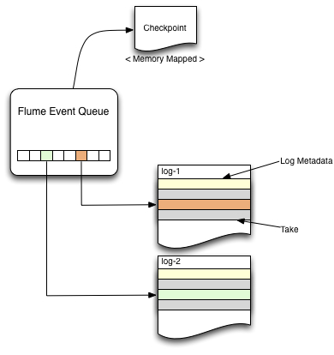
File Channel
Events stored in multiple log files, on disk
Pointers (log id + offset) to events stored in in-memory queue
Queue = current state of the channel.
Log 1
Log 2
Event
Event
Event
Event
Event
Event
Event
Event
Event
Event

Slide 57
File Channel
Queue periodically synced to disk - checkpoint
On channel restart – checkpoint is mmap-ed.
Actions(put/take/commit/rollback) that happened after last checkpoint - replayed from log files
Queue now in same state as it was when channel was stopped – ready for action!

Slide 58
Custom Channels
Usually not required ;)
Most complex Flume component to write!
Implement:
Channel interface
Transaction Interface
Every channel must ensure that the transactional guarantees are respected.
Easier route:
Extend BasicChannelSemantics and BasicTxnSemantics.
Creates thread-local transactions.

Slide 59
Custom Channels
Optional code walkthrough: MemoryChannel

Slide 60
Sinks
Writes data to the next hop or to the final destination.
Flume Sinks:
Avro Sink
HDFS Sink
Hbase Sink
File Sink
Null Sink
Logger Sink

Slide 61
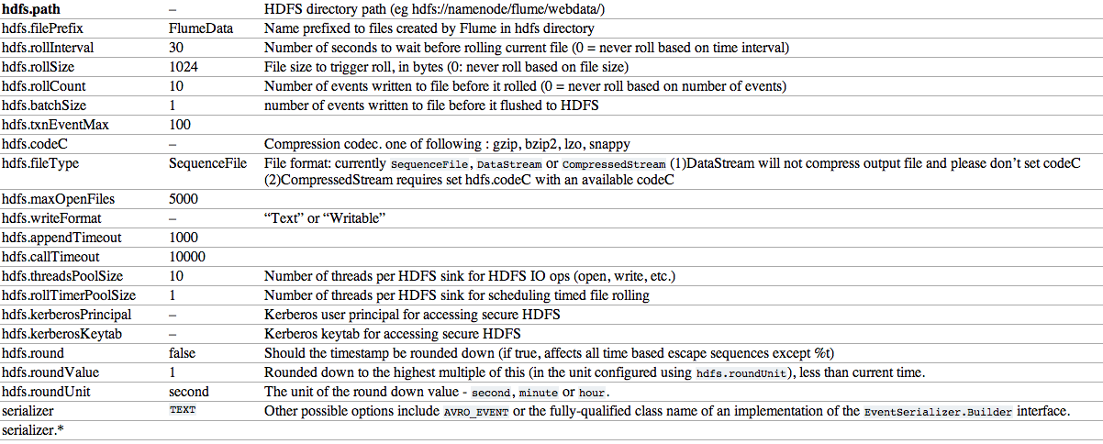
HDFS Sink
Writes events to HDFS (what!)
Configuring (taken from Flume User Guide):

Slide 62
HDFS Sink
Supports dynamic directory naming using tags
Use event headers : %{header}
Eg: hdfs://namenode/flume/%{header}
Use timestamp from the event header
Use various options to use this.
Eg: hdfs://namenode/flume/%{header}/%Y-%m-%D/
Use roundValue and roundUnit to round down the timestamp to use separate directories.
Within a directory – files rolled based on:
rollInterval – time since last event was written
rollSize – max size of the file
rollCount – max # of events per file

Slide 63
AsyncHBase Sink
Insert events and increments into Hbase
Writes events asynchronously at very high rate.
Easy to configure:
table
columnFamily
batchSize - # events per txn.
timeout - how long to wait for success callback
serializer/serializer.* - Custom serializer can decide how and where the events are written out.

Slide 64
Avro Sink
Sends events to the next hop’s Avro Source ☺
Configuring:
hostname
port
batch-size - # events per txn/batch sent to next hop
connect-timeout – how long to wait successful connection
request-timeout – how long to wait for success of batch

Slide 65
Sink Runner and Sink Processors
Sink Runner: Thread which calls SinkProcessor#process().
SinkProcessor manages a sink group which is defined as a top level component.
SinkProcessor#process chooses one of the sinks in its group, based on some criteria
It then calls Sink#process on the selected sink

Slide 66
Custom Sink
Custom sinks written quite often
Allows Flume to write to your own storage system like Cassandra (https://github.com/btoddb/flume-ng-cassandra-sink) or even something like JMS.

Slide 67
Custom Sink
How?
Implement the Sink Interface
Extend the Abstract Sink class
Sink#process method is the key.
Return Status.BACKOFF if no events were available in the channel, else return Status.SUCCESS

Slide 68
Questions?
?

Slide 69

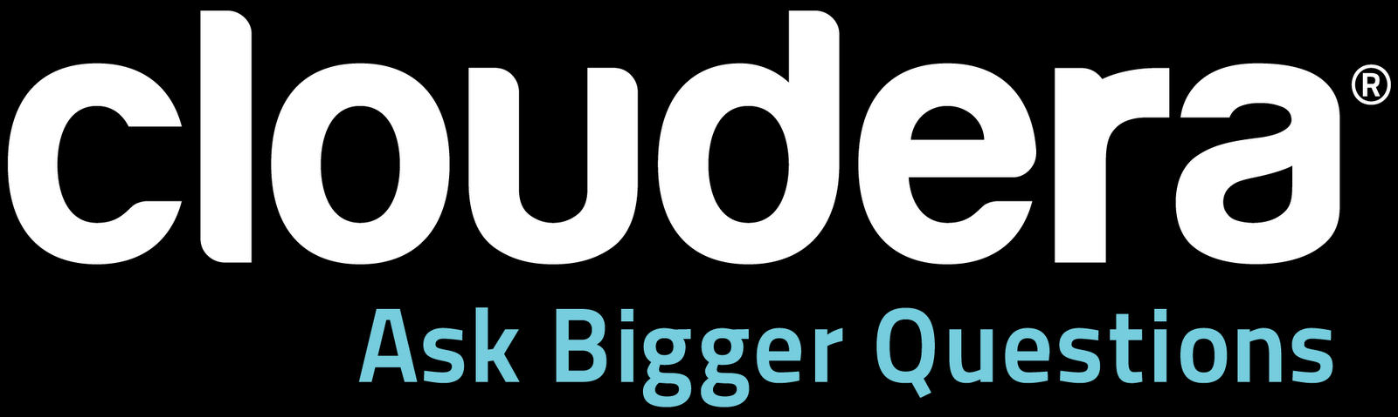
Flume Topologies
Headline Goes Here
Will McQueen | Software Engineer, Cloudera
October 2012
Speaker Name or Subhead Goes Here

Slide 70
Topology #1
Flume SDK's RPC Client
Sources
Interceptors
Channel Selectors
Channels
Sinks

Slide 71
Topology #1
App Tier
Flume Agent Tier 1
Flume Agent Tier 2
Storage Tier
avro
src
agent11
avro
sink
Flume SDK
App-1
file ch
avro
sink
avro
src
agent21
hdfs
sink
avro
src
avro
sink
file ch
Flume SDK
agent12
App-2
HDFS
file ch
avro
sink
avro
src
agent22
hdfs
sink
Flume SDK
avro
src
agent13
avro
sink
file ch
App-3
file ch
avro
sink
. . .
. . .
LB
+
failover
. . .
LB
+
failover

Slide 72
Topology #1
App Tier talks to Flume Agent Tier 1
App-1 uses Flume SDK to build and send Flume events over Avro
Flume Event = [headers] + payload
Contextual routing from headers
Using LoadBalancingRpcClient with 'backoff=true' to get both load balancing and failover
Avro source accepts avro events from multiple clients, up to the # specified in 'threads' prop

Slide 73
Topology #1
Sample Config for 1st Flume Tier
a1.channels = c1
a1.sources = r1
a1.sinks = k1 k2
a1.sinkgroups = g1
a1.sinkgroups.g1.processor.type = LOAD_BALANCE
a1.sinkgroups.g1.processor.selector = ROUND_ROBIN
a1.sinkgroups.g1.processor.backoff = true
a1.channels.c1.type = FILE
a1.sources.r1.channels = c1
a1.sources.r1.type = AVRO
a1.sources.r1.bind = 0.0.0.0
a1.sources.r1.port = 41414
a1.sinks.k1.channel = c1
a1.sinks.k1.type = AVRO
a1.sinks.k1.hostname = a21.example.org
a1.sinks.k1.port = 41414
a1.sinks.k2.channel = c1
a1.sinks.k2.type = AVRO
a1.sinks.k2.hostname = a22.example.org
a1.sinks.k2.port = 41414
Notes:
a1.sinks.k1.channel = c1
a1.sinks.k1.type = AVRO
a1.sinks.k1.hostname = a21.example.org
a1.sinks.k1.port = 41414
a1.sinks.k2.channel = c1
a1.sinks.k2.type = AVRO
a1.sinks.k2.hostname = a22.example.org
a1.sinks.k2.port = 41414

Slide 74
Topology #1
Tier 1 talks to Tier 2 over Avro
Sink groups
Load balancing
Failover

Slide 75
Topology #1
Sample Config for 2nd Flume Tier
a2.channels = c1
a2.sources = r1
a2.sinks = k1
a2.channels.c1.type = FILE
a2.sources.r1.channels = c1
a2.sources.r1.type = AVRO
a2.sources.r1.bind = 0.0.0.0
a2.sources.r1.port = 41414
a2.sinks.k1.channel = c1
a2.sinks.k1.type = HDFS
a2.sinks.k1.hdfs.path = hdfs://namenode.example.org
a2.sinks.k1.hdfs.fileType = DataStream

Slide 76
Topology #2
App Tier
Flume Agent Tier 1
Flume Agent Tier 2
Storage Tier
syslog
src
agent11
avro
sink
App-1
avro
sink
avro
src
hdfs
sink
file ch
. . .
agent21
HDFS
file ch
hbase
sink
syslog
src
agent12
avro
sink
file ch
App-2
avro
sink
avro
src
hdfs
sink
file ch
. . .
agent22
file ch
hbase
sink
syslog
src
agent13
avro
sink
file ch
App-3
avro
sink
HBase
file ch
. . .
. . .
. . .
syslog
. . .
LB
+
failover
LB
+
failover

Slide 77
Topology #2
App Tier talks to Flume Agent Tier 1
App-1 is some syslog-enabled program
Sends syslog events to remote Flume agent that's running with Flume syslog source (UDP or TCP)
Alternatively:
Syslog-enabled program sends to local Flume agent
App-1 could also be a web server
You can use Flume SDK to create client daemon that reads httpd logs, builds the Flume events, and then sends them to tier 1

Slide 78
Topology #2
a1.channels = c1
a1.sources = r1
a1.sinks = k1 k2
a1.sinkgroups = g1
a1.sinkgroups.g1.sinks = k1 k2
a1.sinkgroups.g1.processor.type = LOAD_BALANCE
a1.sinkgroups.g1.processor.selector = ROUND_ROBIN
a1.sinkgroups.g1.processor.backoff = true
a1.channels.c1.type = FILE
a1.sources.r1.channels = c1
a1.sources.r1.type = SYSLOGTCP
a1.sources.r1.host = 0.0.0.0
a1.sources.r1.port = 41414
a1.sinks.k1.channel = c1
a1.sinks.k1.type = AVRO
a1.sinks.k1.hostname = a21.example.org
a1.sinks.k1.port = 41414
a1.sinks.k2.channel = c1
a1.sinks.k2.type = AVRO
a1.sinks.k2.hostname = a22.example.org
a1.sinks.k2.port = 41414
Sample config for 1st flume tier

Slide 79
Topology #2
Contextual Routing in Agent Tier 2
All events are going to HDFS
Only events with high importance are going to HBase
emergency, alert, critical, error
HDFS path bucketing with escape sequences
hdfs://nn.example.org/demo/%Y-%m-%d/%H/%M
FlumeData-%{host}-

Slide 80
Topology #2
Sample config for 2nd Flume Tier
a2.channels = c1
a2.sources = r1
a2.sinks = k1 k2
a2.sinkgroups = g1
a2.sinkgroups.g1.sinks = k1 k2
a2.sinkgroups.g1.processor.type = LOAD_BALANCE
a2.sinkgroups.g1.processor.selector = ROUND_ROBIN
a2.sinkgroups.g1.processor.backoff = true
a2.channels.c1.type = FILE
a2.channels.c1.checkpointDir = /var/run/flume-ng/.flume/ch-1/checkpoint
a2.channels.c1.dataDirs = /var/run/flume-ng/.flume/ch-1/data
a2.channels.c2.type = FILE
a2.channels.c2.checkpointDir = /var/run/flume-ng/.flume/ch-2/checkpoint
a2.channels.c2.dataDirs = /var/run/flume-ng/.flume/ch-2/data
a2.sources.r1.channels = c1 c2
a2.sources.r1.type = AVRO
a2.sources.r1.bind = 0.0.0.0
a2.sources.r1.port = 41414
a2.sources.r1.selector.type = MULTIPLEXING
a2.sources.r1.selector.header = Severity
a2.sources.r1.selector.default = c1
a2.sources.r1.selector.mapping.0 = c1 c2
a2.sources.r1.selector.mapping.1 = c1 c2
a2.sources.r1.selector.mapping.2 = c1 c2
a2.sources.r1.selector.mapping.3 = c1 c2
a2.sinks.k1.channel = c1
a2.sinks.k1.type = HDFS
a2.sinks.k1.hdfs.path = hdfs://nn.example.org/demo/%Y-%m-%d/%H%M/
a2.sinks.k1.hfds.filePrefix = FlumeData-%{host}-
a2.sinks.k1.hdfs.fileType = DataStream
a2.sinks.k1.hdfs.round = true
a2.sinks.k1.hdfs.roundUnit = minute
a2.sinks.k1.hdfs.roundValue = 10
a2.sinks.k2.channel = c2
a2.sinks.k2.type = org.apache.flume.sink.hbase.AsyncHBaseSink
a2.sinks.k2.table = mytable1
a2.sinks.k2.columnFamily = mycolfam1

Slide 81
Topology #2
Using interceptors
For all other source that don't auto-insert host and timestamp like syslog sources do, you can use host interceptor and timestamp interceptor.
Inserts 'host' and 'timestamp' headers
Can chain them
Can choose to preserve existing value

Slide 82
Explore the Flume User Guide
See what flume components are available and the properties used to configure them by reading through the latest Flume User Guide at:
http://flume.apache.org/FlumeUserGuide.html

Slide 83
Questions?
?

Slide 84
Customization, Monitoring & Performance
Headline Goes Here
DO NOT USE PUBLICLY PRIOR TO 10/23/12
Mike Percy | Software Engineer, Cloudera
Speaker Name or Subhead Goes Here

Slide 85

Customization

Slide 86
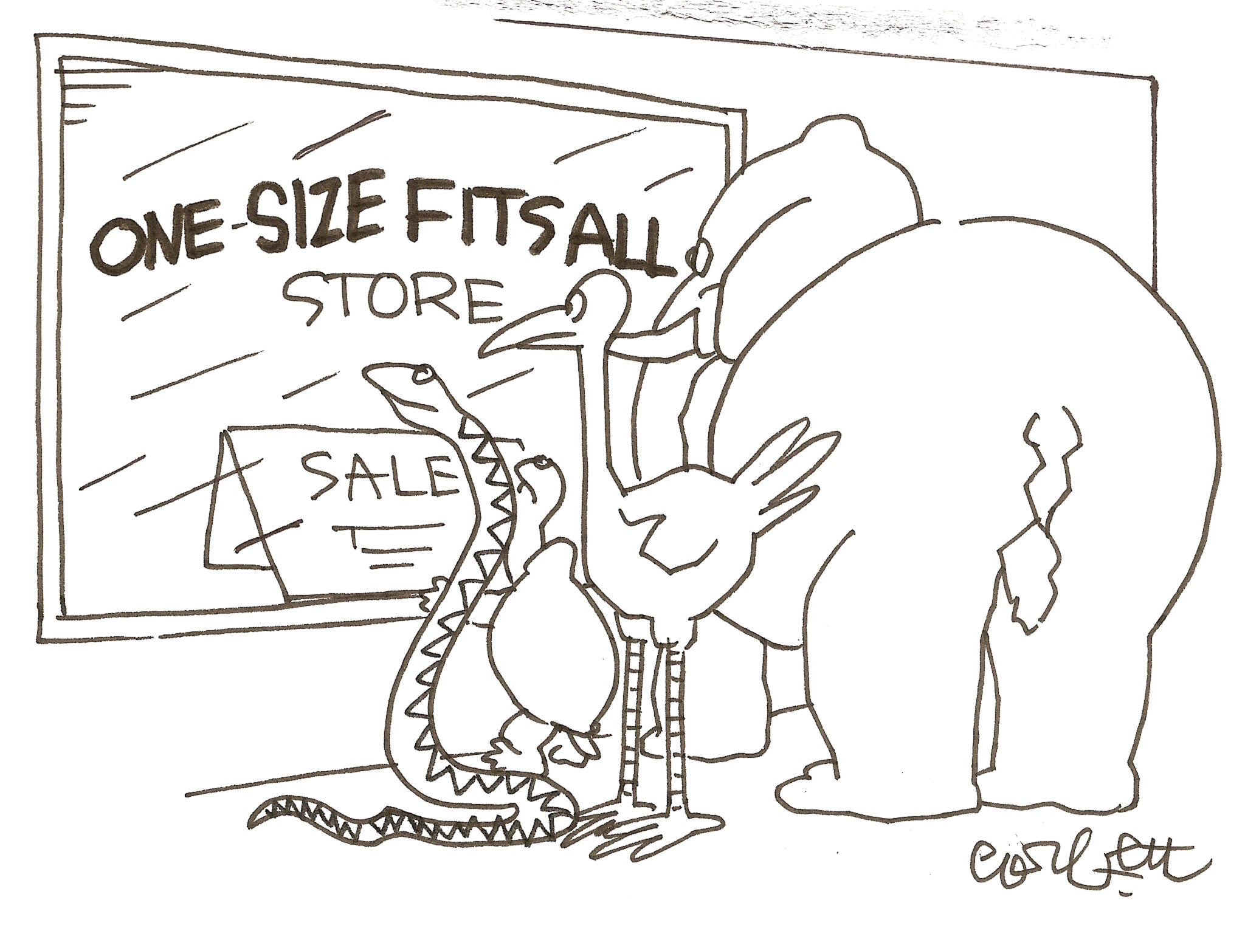
One size does not fit all

Slide 87
Customization
Top-level components
Sources
Channels
Sinks
Sub-components
Serializers
Interceptors
Client SDK

Slide 88
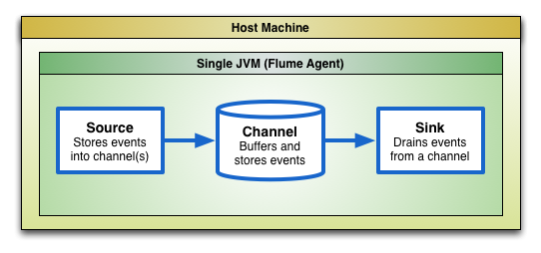
Customization: Top-level components: Architecture

Slide 89
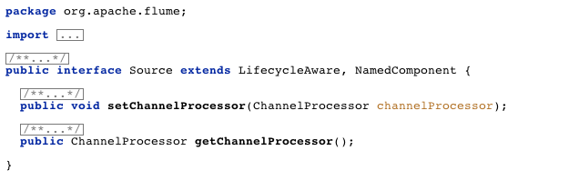
Customization: Top-level components: Sources

Slide 90
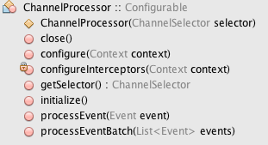
Customization: Top-level components: Sources

Slide 91
Customization: Top-level components: Sources
For examples of how to write a source, look at the Flume source code
NetcatSource
SequenceGeneratorSource

Slide 92
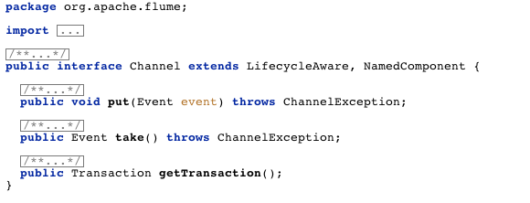
Customization: Top-level components: Channels

Slide 93
Customization: Top-level components: Channels
In practice, channels are tricky to get right
It’s best to not write your own Channel implementation
Work with the community to add or improve existing channels

Slide 94
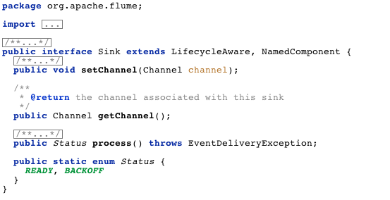
Customization: Top-level components: Sinks

Slide 95
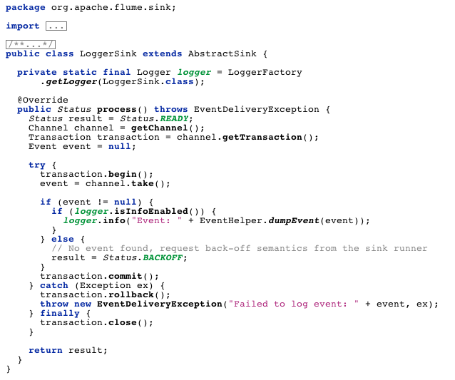
Customization: Top-level components: LoggerSink

Slide 96
Customization: Sub-components: Serializers
Serializers allow full control over how events are written
Native support for raw text and Avro
Easy to extend to support arbitrary formats
CSV
XML
JSON
Protobufs

Slide 97
Customization: Sub-components: EventSerializer
EventSerializer is a file-oriented serialization interface
Supported in the HDFS sink and File Rolling sink

Slide 98
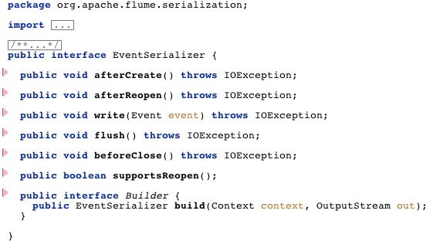
Customization: Sub-components: EventSerializer

Slide 99
Customization: Sub-components: Hbase Serializers
Async Hbase serializers
Hbase serializers

Slide 100
Customization: Sub-components: Interceptors
Interceptors give full access to each event mid-stream
Filtering
Allow or drop events meeting a certain pattern
Routing
Inspect events, add header tags to indicate a destination
Transformation
Convert an event from one format to another

Slide 101
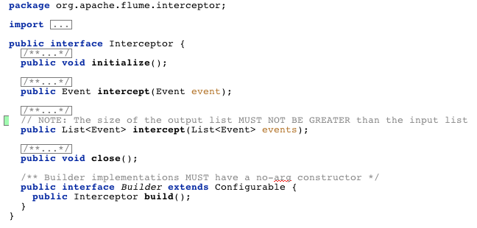
Customization: Sub-components: Interceptors

Slide 102
Customization: Sub-components: Interceptors
Out of the box:
Timestamp Interceptor
Host interceptor
Regex Filtering Interceptor

Slide 103
Customization: Client SDK
The Client SDK allows easy integration of Flume into apps
Load balancing RPC client
Durability guarantees – Avro RPC support
Fast, based on Netty
Flexible and straightforward to use

Slide 104
Customization: Client SDK: Minimal example

Slide 105
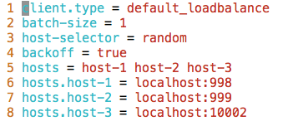
Customization: Client SDK: Minimal example

Slide 106
Monitoring

Slide 107
Monitoring
Protocol support
Configuration
The most useful metrics

Slide 108
Monitoring: protocol support
Several monitoring protocols supported out of the box
JMX
Ganglia
HTTP (JSON)

Slide 109
Monitoring: configuration
Java opts must be set in flume-env.sh to configure monitoring
Ganglia and HTTP monitoring are mutually exclusive

Slide 110
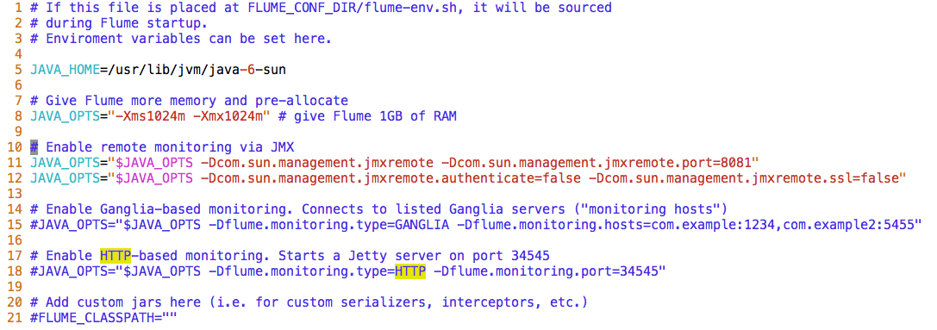
Monitoring: configuration

Slide 111
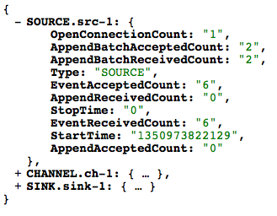
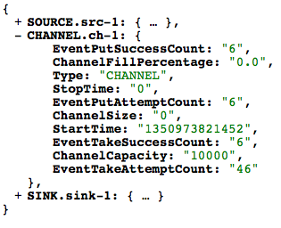
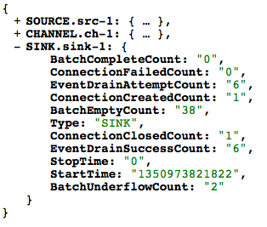
Monitoring: Useful metrics: JSON output
ss | s | s

Slide 112
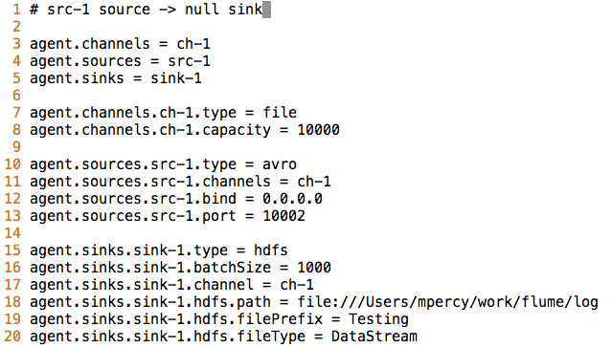
Monitoring: Useful metrics: The config file

Slide 113
Monitoring: Useful metrics: Channel
Channel
ChannelSize
ChannelCapacity
ChannelFillPercentage
EventPut(Attempt/Success)Count
PutAttempt >> PutSuccess means channel is full or misconfigured
EventTake(Attempt/Success)Count
Note: Take attempts will always grow as sinks poll for activity

Slide 114
Monitoring: Useful metrics: Source
Source
Event(Received/Accepted)Count
Append(Received/Accepted)Count
AppendBatch(Accepted/Received)Count

Slide 115
Monitoring: Useful metrics: Sink
Sink
EventDrain(Attempt/Success)Count
Batch(Complete/Underflow)Count

Slide 116
Performance

Slide 117
Performance
Choosing the right channel
File channel
Memory channel
Tuning Flume for performance
Capacity planning
Watching steady state buffer sizes
Modifying the batch size
Incorporating parallelism

Slide 118
Performance: Choosing the right channel
There are two recommended channel implementations:
File channel
Memory channel
Others you may hear mention of:
JDBC channel (superseded by File channel)
RecoverableMemoryChannel (unstable)

Slide 119
Performance: Channels: File channel
High-performance disk-based queue
Guarantees durability of committed events
Flushes to disk at the end of each transaction
Use larger batch sizes to maximize the performance
Able to perform parallel writes to multiple disks
Cheaper per GB than Memory channel, yet scalable
Able to buffer lots of data when there is a downstream outage

Slide 120
Performance: Channels: Memory channel
Limited durability guarantees
Events stored only in memory
Very low read/write latencies
Less sensitive to batch size settings than File Channel
Single-event transactions are still pretty fast
Limited by available physical RAM
Much higher cost per GB than File channel
Lower capacity, so less able to tolerate downstream outages

Slide 121
Performance: Tuning: Capacity planning
Rules of thumb
At any given hop, consider how much downtime you want to tolerate. Set your channel capacity to tolerate it
e.g.: Tolerate 1 hour of downtime. Rate = 1,000 events/sec
Channel capacity = 1,000 events/sec * 60 sec/min * 60 min/hour
Channel capacity = 3,600,000 events
Plan for 2 or more Flume agent tiers: collection & storage
Use a load-balancing sink processor to spread the load
20:1 or 30:1 ratio of clients to collection agents is reasonable

Slide 122
Performance: Tuning: Steady-state ChannelSize
Critical metric: ChannelSize at each hop
Watch ChannelSize to pinpoint bottlenecks in the flow

Slide 123
Performance: Tuning: Batch Size
Batch size affects throughput and duplication under failure
The higher the batch size, the better performance, but…
If there is a failure mid-transaction, as many as batchSize Events may be duplicated (re-tried) downstream
Rule of thumb:
Batch sizes of 100 or 1,000 or 10,000 may be optimal depending on event size, throughput, etc.

Slide 124
Performance: Tuning: Batch Size
Batch size should equal sum of batch sizes of input streams

Slide 125
Performance: Tuning: Using parallelism
Sinks are single-threaded
Attach multiple sinks to a single channel: Increase throughput

Slide 126
Questions?
?

Slide 127


